Slide 1
EE224 Signals and Systems I
Lab 3
Signals with Time-Varying Frequency

Slide 2
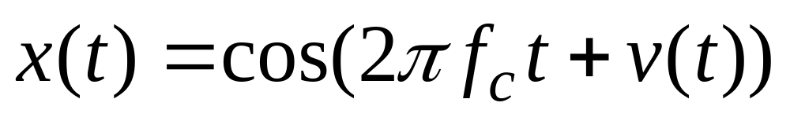
Time-Varying Frequency
Frequency can change vs. time
  Continuously, not stepped
FREQUENCY MODULATION (FM)
CHIRP SIGNALS
  Linear Frequency Modulation (LFM)
VOICE

Slide 3
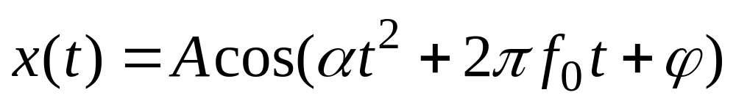
New Signal: Linear FM
Called Chirp Signals (LFM)
  Quadratic phase
Freq will change LINEARLY vs. time
  Example of Frequency Modulation (FM)
  Define “instantaneous frequency”
QUADRATIC

Slide 4
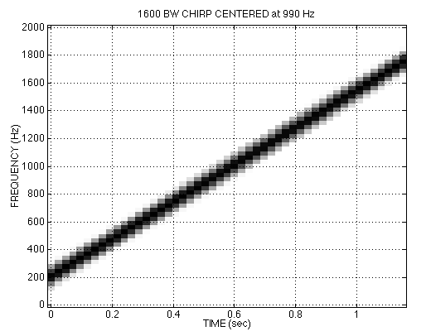

CHIRP SPECTROGRAM

Slide 5
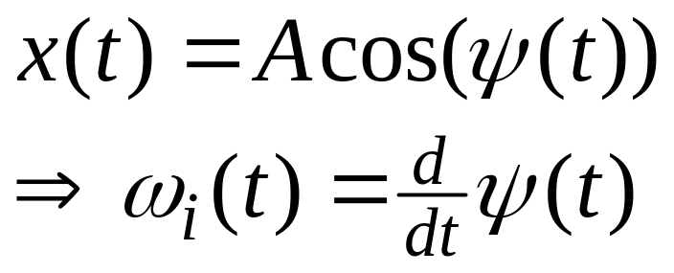
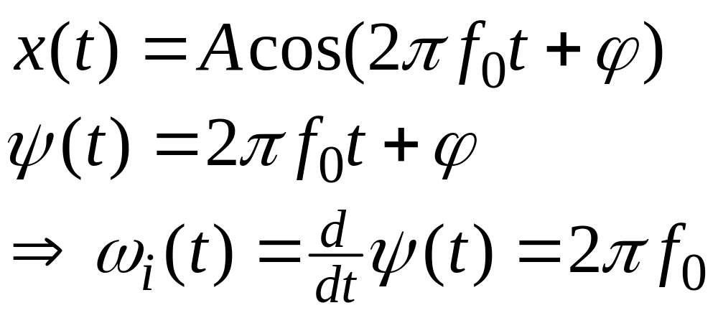
INSTANTANEOUS FREQ
Definition
For Sinusoid:
Derivative
of the “Angle”
Makes sense

Slide 6
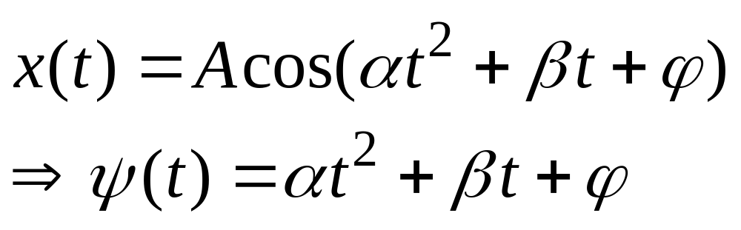
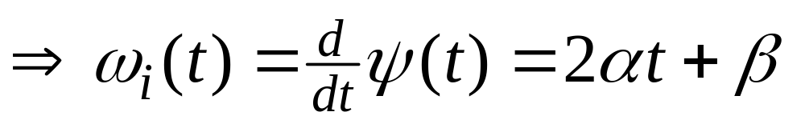
INSTANTANEOUS FREQ of the Chirp
Chirp Signals have Quadratic phase
Freq will change LINEARLY vs. time

Slide 7
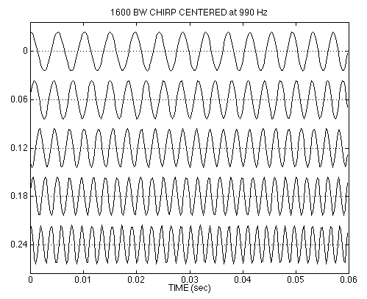
CHIRP WAVEFORM

Slide 8
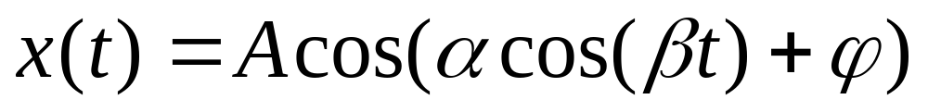
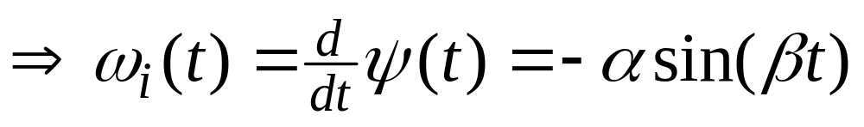
OTHER CHIRPS
ψ(t) can be anything:
ψ(t) could be speech or music:
  FM radio broadcast

Slide 9
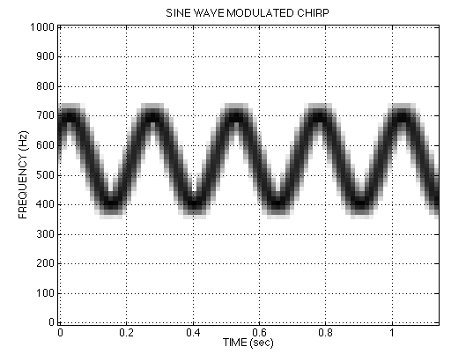
SINE-WAVE FREQUENCY MODULATION (FM)
Look at CD-ROM Demos in Ch 3

Slide 10
Natural Chirps
Interesting chirps occur in nature
  Bats use chirp for echolocation
  http://www.bio.bris.ac.uk/research/bats/calls/
  Dolphins and Killer Whales for communication and echolocation
Radar systems use chirp for more precise distance estimation

Slide 11
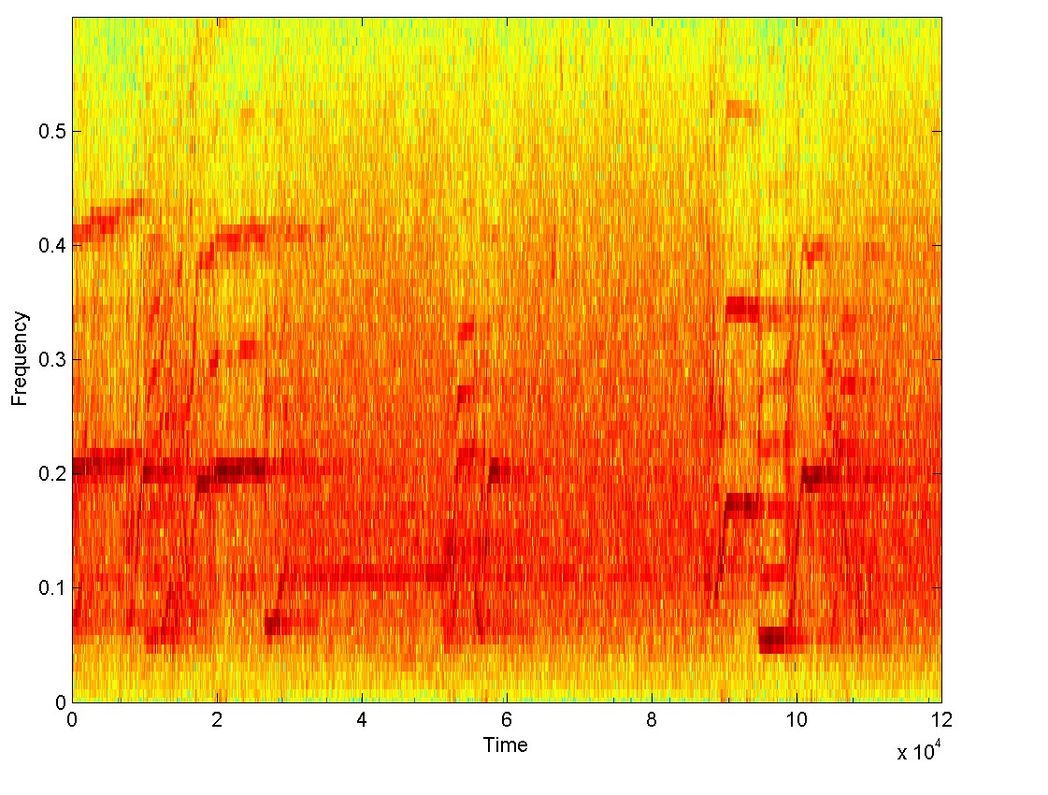
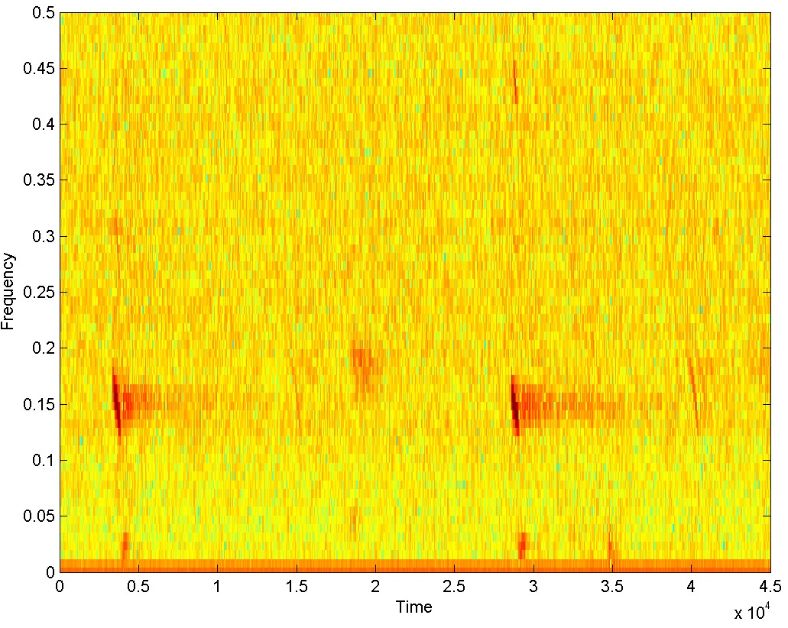
Spectra of Bat and Whale
Spectrogram of bat sound
Spectrogram of Whale Sounds

